Slide 1
unit -2 TEST CASE DESIGN

Slide 2
Test case Design Strategies
Test case design techniques are the key to planning, designing, and implementing tests for software applications. These techniques involve various steps that aim to ensure the effectiveness of test cases in uncovering bugs or other defects in software programs.

Slide 3
A basic example of test case design
Let us take an example of any e-commerce app or website(like Amazon or Flipkart)for test case design. We want to ensure users can quickly checkout and make payments without issues. Here we test for 1 product in the cart; we will see later that this test case design technique is a boundary value analysis technique.
Title: Test that user can complete the checkout process when there is 1 item in the card.
Description: Ensure users can checkout and make payments without issues on the website/app
Preconditions: The user is already logged in

Slide 4
Assumptions: They are using a supported device or browser to log in.
Test Steps:
Open the app/website.
Go to 1 product
Add the product to the cart.
Check out the item in the cart.
Add address information for delivery
Add payment information
Complete the checkout process.
Expected Result: The checkout process should be complete, and the user should receive confirmation.

Slide 5
Using Black Bod Approach to Test Case Design
The black box is a powerful technique to check the application under test from the user’s perspective. Black box testing is used to test the system against external factors responsible for software failures. This testing approach focuses on the input that goes into the software, and the output that is produced. The testing team does not cover the inside details such as code, server logic, and development method.
Black box testing is based on the requirements and checks the system to validate against predefined requirements.

Slide 6
Various parameters checked in black box testing are:
Accurate actions performed by users
System’s interaction with the inputs
The response time of the system
Use of data structures Issues in the user interface
Usability issues
Performance issues
Abrupt application failure, unable to start or finish

Slide 7
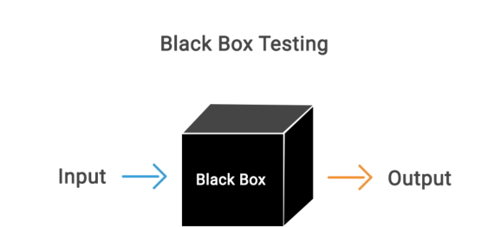

Slide 8
Types of Black Box Testing
Functional testing – This is a type of black box testing which is related to the functional requirements of a system; Functional testing is concerned only with the functional requirements of a system and covers how well the system executes its functions.
Non-functional testing – This black box testing type is not related to testing of specific functionality, Non functional testing is concerned with the non-functional requirements and is designed specifically to evaluate the readiness of a system according to the various criteria which are not covered by functional testing.
Regression testing – Regression Testing is performed after code fixes, upgrades or any other system maintenance to check the new changes has not affected any existing functionality.

Slide 9
Black box testing example:
A simple login screen of software or a web application will be tested for seamless user login. The login screen has two fields, username and password as an input and the output will be to enable access to the system.
A black box testing will not consider the specifications of the code, and it will test the valid username and password to login to the right account.
This form of testing technique will check the input and output.
A user logged in when inputs a present username and correct password
A user receives an error message when enters username and incorrect password

Slide 10
The black box testing is also known as an opaque, closed box, function-centric testing. It emphasizes on the behavior of the software. Black box testing checks scenarios where the system can break.
For example, a user might enter the password in the wrong format, and a user might not receive an error message on entering an incorrect password.

Slide 11
Random Testing
Random testing is software testing in which the system is tested with the help of generating random and independent inputs and test cases. Random testing is also named monkey testing. It is a black box assessment outline technique in which the tests are being chosen randomly and the results are being compared by some software identification to check whether the output is correct or incorrect

Slide 12
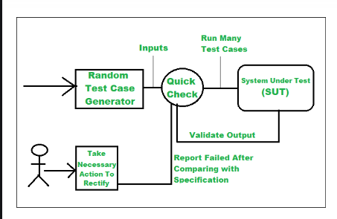
Working Random Testing:
Step-1: Identify Input domain
Step-2: Select test inputs independently/randomly from the input domain
Step-3: Test the system on these inputs and form a random test set
Step-4: Compare the result with system specification
Step-5: If the Report fails then take necessary action.

Slide 13
Requirements based testing
Requirements-based testing is a testing approach in which test cases, conditions and data are derived from requirements. It includes functional tests and also non-functional attributes such as performance, reliability or usability.
Stages in Requirements based Testing:
Defining Test Completion Criteria - Testing is completed only when all the functional and non-functional testing is complete.
Design Test Cases - A Test case has five parameters namely the initial state or precondition, data setup, the inputs, expected outcomes and actual outcomes.
Execute Tests - Execute the test cases against the system under test and document the results.
Verify Test Results - Verify if the expected and actual results match each other.

Slide 14
Verify Test Coverage - Verify if the tests cover both functional and non-functional aspects of the requirement.
Track and Manage Defects - Any defects detected during the testing process goes through the defect life cycle and are tracked to resolution. Defect Statistics are maintained which will give us the overall status of the project.

Slide 15
Requirements Testing process:
Testing must be carried out in a timely manner.
Testing process should add value to the software life cycle, hence it needs to be effective.
Testing the system exhaustively is impossible hence the testing process needs to be efficient as well.
Testing must provide the overall status of the project, hence it should be manageable.

Slide 16
Functional testing is a type of software testing in which the system is tested against the functional requirements of the system. It is conducted to ensure that the requirements are properly satisfied by the application. Functional testing verifies that each function of the software application works in conformance with the requirement and specification. Boundary Value Analysis(BVA) is one of the functional testings.
Black box testing – Software Engineering
Black-box testing is a type of software testing in which the tester is not concerned with the internal knowledge or implementation details of the software but rather focuses on validating the functionality based on the provided specifications or requirements.

Slide 17
Boundary Value Analysis
Boundary value analysis is one of the widely used case design technique for black box testing. It is used to test boundary values because the input values near the boundary have higher chances of error.
Whenever we do the testing by boundary value analysis, the tester focuses on, while entering boundary value whether the software is producing correct output or not.
Boundary values are those that contain the upper and lower limit of a variable. Assume that, age is a variable of any function, and its minimum value is 18 and the maximum value is 30, both 18 and 30 will be considered as boundary values.

Slide 18
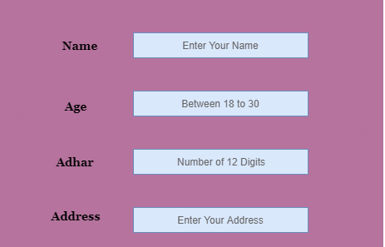
The basic assumption of boundary value analysis is, the test cases that are created using boundary values are most likely to cause an error.
There is 18 and 30 are the boundary values that's why tester pays more attention to these values, but this doesn't mean that the middle values like 19, 20, 21, 27, 29 are ignored. Test cases are developed for each and every value of the range.

Slide 19
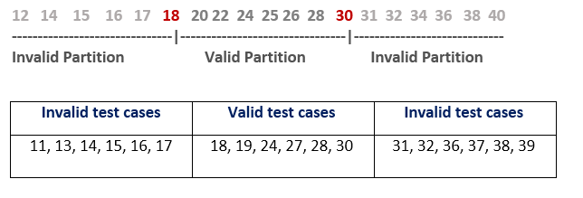
Imagine, there is a function that accepts a number between 18 to 30, where 18 is the minimum and 30 is the maximum value of valid partition, the other values of this partition are 19, 20, 21, 22, 23, 24, 25, 26, 27, 28 and 29. The invalid partition consists of the numbers which are less than 18 such as 12, 14, 15, 16 and 17, and more than 30 such as 31, 32, 34, 36 and 40. Tester develops test cases for both valid and invalid partitions to capture the behavior of the system on different input conditions.

Slide 20
The software system will be passed in the test if it accepts a valid number and gives the desired output, if it is not, then it is unsuccessful. In another scenario, the software system should not accept invalid numbers, and if the entered number is invalid, then it should display error massage.
If the software which is under test, follows all the testing guidelines and specifications then it is sent to the releasing team otherwise to the development team to fix the defects.

Slide 21
Equivalence Partitioning Method
Equivalence Partitioning Method is also known as Equivalence class partitioning (ECP). It is a software testing technique or black-box testing that divides input domain into classes of data, and with the help of these classes of data, test cases can be derived. An ideal test case identifies class of error that might require many arbitrary test cases to be executed before general error is observed. In equivalence partitioning, equivalence classes are evaluated for given input conditions. Whenever any input is given, then type of input condition is checked, then for this input conditions, Equivalence class represents or describes set of valid or invalid states.

Slide 22
Guidelines for Equivalence Partitioning :
If the range condition is given as an input, then one valid and two invalid equivalence classes are defined.
If a specific value is given as input, then one valid and two invalid equivalence classes are defined.
If a member of set is given as an input, then one valid and one invalid equivalence class is defined.
If Boolean no. is given as an input condition, then one valid and one invalid equivalence class is defined.

Slide 24
Example-1: Let us consider an example of any college admission process. There is a college that gives admissions to students based upon their percentage. Consider percentage field that will accept percentage only between 50 to 90 %, more and even less than not be accepted, and application will redirect user to an error page. If percentage entered by user is less than 50 %or more than 90 %, that equivalence partitioning method will show an invalid percentage. If percentage entered is between 50 to 90 %, then equivalence partitioning method will show valid percentage.

Slide 26
State Transition Testing
is a type of software testing which is performed to check the change in the state of the application under varying input. The condition of input passed is changed and the change in state is observed.
State Transition Testing is basically a black box testing technique that is carried out to observe the behavior of the system or application for different input conditions passed in a sequence.
In this type of testing, both positive and negative input values are provided and the behavior of the system is observed. State Transition Testing is basically used where different system transitions are needed to be tested.

Slide 28
Objectives of State Transition Testing
Determining the System States: Identify and record the different states that the system that is being tested can be in. These phases are frequently connected to certain circumstances or occurrences inside the system.
State Transition Modelling: It makes a model or state transition diagram that shows the system’s various states and the changes between them.
Verifying Legitimate State Transitions: Check that the system responds to various inputs or events by switching between valid states in a correct manner. By doing this, it is ensured that the system transitions between states with expected behaviour.

Slide 30
Checking the Beginning and End States: Verify that, following a series of actions or events, the system finishes in the expected final state and begins in the proper beginning state. This guarantees correct system setup and dismantling.
Error Correction and Recovery: Examine the system’s capacity to recover from unforeseen conditions and accept faults with patience. This covers situations in which the system operates and runs into unexpected inputs or events.

Slide 31
Transition States:
Change Mode: When this mode is activated then the display mode moves from TIME to DATE.
Reset: When the display mode is TIME or DATE, then reset mode sets them to ALTER TIME or ALTER DATE respectively.
Time Set: When this mode is activated, display mode changes from ALTER TIME to TIME.
Date Set: When this mode is activated, display mode changes from ALTER DATE to DATE.
State Transition Diagram:
State Transition Diagram shows how the state of the system changes on certain inputs. It has four main components:
States
Transition
Events
Actions

Slide 32
Advantages of State Transition Testing
Clear Visualization: The different states and transitions in the system are clearly represented visually through the use of state transition diagrams. Better comprehension, communication and documentation of the system’s behavior are made possible by this visualization.
Effective Test Design: Effective test case design is facilitated by the modelling of states and transitions. Based on the state transition diagram, testers can create test scenarios that encompass both legitimate and illegitimate state changes.
Early Error Detection: Early fault discovery in relation to state transitions is aided by state transition testing. Testers can detect and fix problems early in the development life cycle by methodically testing various transitions.

Slide 33
Disadvantages of State Transition Testing:
Having Trouble Identifying States: It might be difficult to recognize and characterize every state that a complicated system can have. Neglecting crucial testing situations could be the consequence of incomplete state identification.
Failed to Evaluate Combinations: Individual state modifications and transitions are the main focus of state transition testing. It might not sufficiently cover testing of various state combinations, which is important for some systems.
Risk of Omission: When creating and running test cases, there’s a chance that some situations or state transitions will be missed, which could result in insufficient test coverage.

Slide 34
Cause and Effect Graph
Cause-effect graph comes under the black box testing technique which underlines the relationship between a given result and all the factors affecting the result. It is used to write dynamic test cases.
The dynamic test cases are used when code works dynamically based on user input. For example, while using email account, on entering valid email, the system accepts it but, when you enter invalid email, it throws an error message. In this technique, the input conditions are assigned with causes and the result of these input conditions with effects.

Slide 35
Cause-Effect graph technique is based on a collection of requirements and used to determine minimum possible test cases which can cover a maximum test area of the software.
The main advantage of cause-effect graph testing is, it reduces the time of test execution and cost.
This technique aims to reduce the number of test cases but still covers all necessary test cases with maximum coverage to achieve the desired application quality.
Cause-Effect graph technique converts the requirements specification into a logical relationship between the input and output conditions by using logical operators like AND, OR and NOT.

Slide 36
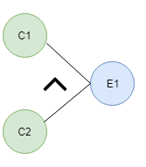
Notations used in the Cause-Effect Graph
AND - E1 is an effect and C1 and C2 are the causes. If both C1 and C2 are true, then effect E1 will be true.

Slide 37
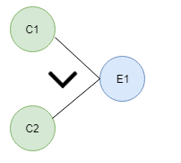
OR.- If any cause from C1 and C2 is true, then effect E1 will be true.
NOT - If cause C1 is false, then effect E1 will be true

Slide 38
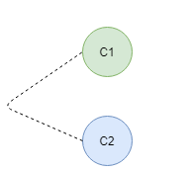
Mutually Exclusive - When only one cause is true.

Slide 39
Situation:
The character in column 1 should be either A or B and in the column 2 should be a digit. If both columns contain appropriate values then update is made. If the input of column 1 is incorrect, i.e. neither A nor B, then message X will be displayed. If the input in column 2 is incorrect, i.e. input is not a digit, then message Y will be displayed.
A file must be updated, if the character in the first column is either "A" or "B" and in the second column it should be a digit.
If the value in the first column is incorrect (the character is neither A nor B) then massage X will be displayed.
If the value in the second column is incorrect (the character is not a digit) then massage Y will be displayed.

Slide 41
Now, we are going to make a Cause-Effect graph for the above situation:
Causes are:
C1 - Character in column 1 is A
C2 - Character in column 1 is B
C3 - Character in column 2 is digit!
Effects:
E1 - Update made (C1 OR C2) AND C3
E2 - Displays Massage X (NOT C1 AND NOT C2)
E3 - Displays Massage Y (NOT C3)
Where AND, OR, NOT are the logical gates.

Slide 43
Effect E1- Update made- The logic for the existence of effect E1 is "(C1 OR C2) AND C3". For C1 OR C2, any one from C1 and C2 should be true. For logic AND C3 (Character in column 2 should be a digit), C3 must be true. In other words, for the existence of effect E1 (Update made) any one from C1 and C2 but the C3 must be true. We can see in graph cause C1 and C2 are connected through OR logic and effect E1 is connected with AND logic.
Effect E2 - Displays Massage X - The logic for the existence of effect E2 is "NOT C1 AND NOT C2" that means both C1 (Character in column 1 should be A) and C2 (Character in column 1 should be B) should be false. In other words, for the existence of effect E2 the character in column 1 should not be either A or B. We can see in the graph, C1 OR C2 is connected through NOT logic with effect E2.

Slide 44
Effect E3 - Displays Massage Y- The logic for the existence of effect E3 is "NOT C3" that means cause C3 (Character in column 2 is a digit) should be false. In other words, for the existence of effect E3, the character in column 2 should not be a digit. We can see in the graph, C3 is connected through NOT logic with effect E3.
So, it is the cause-effect graph for the given situation. A tester needs to convert causes and effects into logical statements and then design cause-effect graph. If function gives output (effect) according to the input (cause) so, it is considered as defect free, and if not doing so, then it is sent to the development team for the correction.

Slide 45
Compatibility testing
Compatibility testing is software testing which comes under the non functional testing category, and it is performed on an application to check its compatibility (running capability) on different platform/environments. This testing is done only when the application becomes stable.
Means simply this compatibility test aims to check the developed software application functionality on various software, hardware platforms, network and browser etc. This compatibility testing is very important in product production and implementation point of view as it is performed to avoid future issues regarding compatibility.

Slide 46
Types of Compatibility Testing : Several examples of compatibility testing are given below.
1. Software :
Testing the compatibility of an application with an Operating System like Linux, Mac, Windows
Testing compatibility on Database like Oracle SQL server, MongoDB server.
Testing compatibility on different devices like in mobile phones, computers.
Types based on Version Testing :
There are two types of compatibility testing based on version testing
Forward compatibility testing : When the behavior and compatibility of a software or hardware is checked with its newer version then it is called as forward compatibility testing.
Backward compatibility testing : When the behavior and compatibility of a software or hardware is checked with its older version then it is called as backward compatibility testing.

Slide 47
2.Hardware :
Checking compatibility with a particular size of
RAM
ROM
Hard Disk
Memory Cards
Processor
Graphics Card
3. Smartphones :
Checking compatibility with different mobile platforms like android, iOS etc.
4.Network :
Checking compatibility with different :
Bandwidth
Operating speed
Capacity

Slide 48
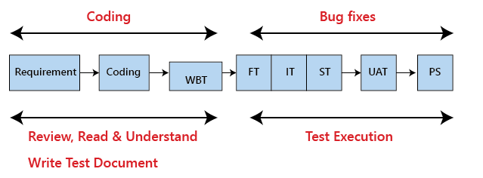
user documentation testing
Testing documentation is the documentation of artifacts that are created during or before the testing of a software application. Documentation reflects the importance of processes for the customer, individual and organization.
Projects which contain all documents have a high level of maturity. Careful documentation can save the time, efforts and wealth of the organization.

Slide 49
There is the necessary reference document, which is prepared by every test engineer before stating the test execution process. Generally, we write the test document whenever the developers are busy in writing the code.
Once the test document is ready, the entire test execution process depends on the test document. The primary objective for writing a test document is to decrease or eliminate the doubts related to the testing activities.

Slide 51
Test Scenarios
It is a document that defines the multiple ways or combinations of testing the application. Generally, it is prepared to understand the flow of an application. It does not consist of any inputs and navigation steps.
Test case
It is an in-details document that describes step by step procedure to test an application. It consists of the complete navigation steps and inputs and all the scenarios that need to be tested for the application. We will write the test case to maintain the consistency, or every tester will follow the same approach for organizing the test document.

Slide 52
Test plan
It is a document that is prepared by the managers or test lead. It consists of all information about the testing activities. The test plan consists of multiple components such as Objectives, Scope, Approach, Test Environments, Test methodology, Template, Role & Responsibility, Effort estimation, Entry and Exit criteria, Schedule, Tools, Defect tracking, Test Deliverable, Assumption, Risk, and Mitigation Plan or Contingency Plan.
Requirement Traceability Matrix (RTM)
The Requirement traceability matrix [RTM] is a document which ensures that all the test case has been covered. This document is created before the test execution process to verify that we did not miss writing any test case for the particular requirement.

Slide 53
Test strategy
The test strategy is a high-level document, which is used to verify the test types (levels) to be executed for the product and also describe that what kind of technique has to be used and which module is going to be tested. The Project Manager can approve it. It includes the multiple components such as documentation formats, objective, test processes, scope, and customer communication strategy, etc. we cannot modify the test strategy.
Test data
It is data that occurs before the test is executed. It is mainly used when we are implementing the test case. Mostly, we will have the test data in the Excel sheet format and entered manually while performing the test case.
The test data can be used to check the expected result, which means that when the test data is entered, the expected outcome will meet the actual result and also check the application performance by entering the in-correct input data.

Slide 54
Bug report
The bug report is a document where we maintain a summary of all the bugs which occurred during the testing process. This is a crucial document for both the developers and test engineers because, with the help of bug reports, they can easily track the defects, report the bug, change the status of bugs which are fixed successfully, and also avoid their repetition in further process.
Test execution report
It is the document prepared by test leads after the entire testing execution process is completed. The test summary report defines the constancy of the product, and it contains information like the modules, the number of written test cases, executed, pass, fail, and their percentage. And each module has a separate spreadsheet of their respective module.

Slide 55
Why documentation is needed
If the testing or development team gets software that is not working correctly and developed by someone else, so to find the error, the team will first need a document. Now, if the documents are available then the team will quickly find out the cause of the error by examining documentation.
But, if the documents are not available then the tester need to do black box and white box testing again, which will waste the time and money of the organization.More than that, Lack of documentation becomes a problem for acceptance.

Slide 56
Benefits of using Documentation
Documentation clarifies the quality of methods and objectives.
It ensures internal coordination when a customer uses software application.
It ensures clarity about the stability of tasks and performance.
It provides feedback on preventive tasks.
It provides feedback for your planning cycle.

Slide 57
The drawback of the test document
It is a bit tedious because we have to maintain the modification provided by the customer and parallel change in the document.
If the test documentation is not proper, it will replicate the quality of the application.
Sometimes it is written by that person who does not have the product knowledge.
Sometimes the cost of the document will be exceeding its value.

Slide 58
Domain Testing :
It is a software testing technique where minimum numbers of inputs are used to access appropriate output of a system, to ensure the system does not accept invalid input values. The system is expected to give required outputs blocking the invalid inputs.
Importance of Domain Testing
Protection of Input Space: A software application’s complete input area should be sufficiently covered, and domain testing helps to verify this. It seeks to identify possible problems with data handling and processing by testing particular domains or ranges of input values.
Error detection: It works well for identifying mistakes or irregularities that could happen in particular input domains. Through the focus of testing efforts on pertinent subsets, domain testing can identify issues that may be missed in more general, random testing situations.

Slide 59
Preventing Bugs: Software can be designed with fewer vulnerabilities and critical situations if developers have a better understanding of the properties and limits of input domains. By taking a proactive approach to input domain consideration, issues may be avoided before they even arise.
Enhanced Efficiency of Tests: Domain testing aids in organizing testing efforts according to the software’s most important and pertinent sections. Because more resources are allocated to testing scenarios that are more likely to uncover significant faults, test effectiveness is raised as a result.

Slide 60
Test adequacy criteria
The goal for white box testing is to ensure that the internal components of a program are working properly. A common focus is on structural elements such as statements and branches. The tester develops test cases that exercise these structural elements to determine if defects exist in the program structure. The term exercise is used in this context to indicate that the target structural elements are executed when the test cases are run. By exercising all of the selected structural elements the tester hopes to improve the chances for detecting defects.

Slide 61
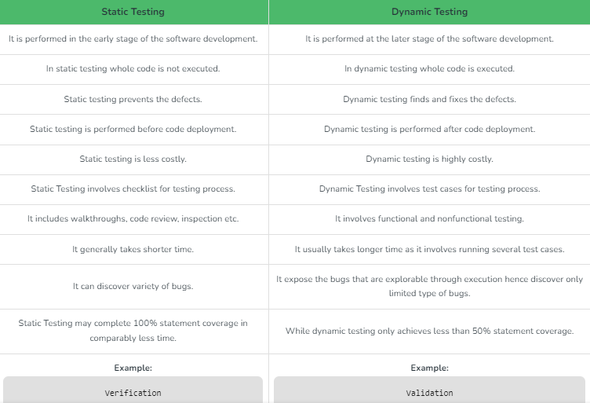

Slide 62
Functional Testing
Functional testing is basically defined as a type of testing that verifies that each function of the software application works in conformance with the requirement and specification. This testing is not concerned with the source code of the application. Each functionality of the software application is tested by providing appropriate test input, expecting the output, and comparing the actual output with the expected output. This testing focuses on checking the user interface, APIs, database, security, client or server application, and functionality of the Application Under Test. Functional testing can be manual or automated.

Slide 63
Purpose of Functional Testing
Functional testing mainly involves black box testing and can be done manually or using automation. The purpose of functional testing is to:
Test each function of the application: Functional testing tests each function of the application by providing the appropriate input and verifying the output against the functional requirements of the application.
Test primary entry function: In functional testing, the tester tests each entry function of the application to check all the entry and exit points.
Test flow of the GUI screen: In functional testing, the flow of the GUI screen is checked so that the user can navigate throughout the application.

Slide 64
Coverage and Control Flow Graphs
The application of coverage analysis is typically associated with the use of control and data flow models to represent program structural elements and data. The logic elements most commonly considered for coverage are based on the flow of control in a unit of code. For example,
(i) program statements;
(ii) decisions/branches (these influence the program flow of control);
(iii) conditions (expressions that evaluate to true/false, and do not contain any other true/false-valued expressions);
(iv)combinations of decisions and conditions;
(v) paths (node sequences in flow graphs).

Slide 65
Code Coverage
Code coverage is a software testing metric also termed as Code Coverage Testing which helps in determining how much code of the source is tested which helps in accessing the quality of the test suite and analyzing how comprehensively a software is verified. Actually in simple code coverage refers to the degree to which the source code of the software code has been tested. This Code Coverage is considered as one of the forms of white box testing.

Slide 66
As we know at last of the development each client wants a quality software product as well and the developer team is also responsible for delivering a quality software product to the customer/client. Where this quality refers to the product’s performance, functionalities, behavior, correctness, reliability, effectiveness, security, and maintainability. Where Code Coverage metric helps in determining the performance and quality aspects of any software. The formula to calculate code coverage is
Code Coverage = (Number of lines of code executed)/(Total Number of lines of code in a system component) * 100

Slide 67
Code Coverage Criteria
To perform code coverage analysis various criteria are taken into consideration. These are the major methods/criteria which are considered.
Statement Coverage/Block coverage:
The number of statements that have been successfully executed in the program source code.
Statement Coverage = (Number of statements executed)/(Total Number of statements)*100.
Decision Coverage/Branch Coverage:
The number of decision control structures that have been successfully executed in the program source code.
Decision Coverage = (Number of decision/branch outcomes exercised)/(Total number of decision outcomes in the source code)*100.

Slide 68
Function coverage:
The number of functions that are called and executed at least once in the source code.
Function Coverage = (Number of functions called)/(Total number of function)*100.
Condition Coverage/Expression Coverage:
The number of Boolean condition/expression statements executed in the conditional statement.
Condition Coverage =(Number of executed operands)/(Total Number of Operands)*100.

Slide 69
Advantages of Using Code Coverage
It helps in determining the performance and quality aspects of any software.
It helps in evaluating quantitative measures of code coverage.
It helps in the easy maintenance of the code base.
It helps in accessing the quality of the test suite and analyzing how comprehensively a software is verified.
It helps in the exposure of bad, dead, and unused code.
It helps in creating extra test cases to increase coverage.
It helps in developing the software product faster by increasing its productivity and efficiency.

Slide 70
Disadvantages of Using Code Coverage
Sometimes it fails to cover code completely and correctly.
It can not guarantee that all possible values of a feature are tested with the help of code coverage.
It fails to ensure how perfectly the code has been covered.
For some test files, additional mock data is required to execute the test cases.
Sometimes it is difficult to cover the test cases forevent-handlingg functions.

Slide 71
Path Testing
Path Testing is a method that is used to design the test cases. In the path testing method, the control flow graph of a program is designed to find a set of linearly independent paths of execution. In this method, Cyclomatic Complexity is used to determine the number of linearly independent paths and then test cases are generated for each path.
It gives complete branch coverage but achieves that without covering all possible paths of the control flow graph. McCabe’s Cyclomatic Complexity is used in path testing. It is a structural testing method that uses the source code of a program to find every possible executable path.

Slide 73
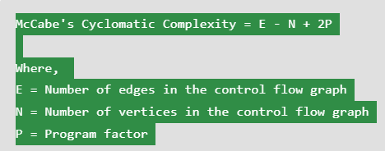
Control Flow Graph: Draw the corresponding control flow graph of the program in which all the executable paths are to be discovered.
Cyclomatic Complexity: After the generation of the control flow graph, calculate the cyclomatic complexity of the program using the following formula.

Slide 74
Make Set: Make a set of all the paths according to the control flow graph and calculate cyclomatic complexity. The cardinality of the set is equal to the calculated cyclomatic complexity.
Create Test Cases: Create a test case for each path of the set obtained in the above step

Slide 75
Path Testing Techniques
Control Flow Graph: The program is converted into a control flow graph by representing the code into nodes and edges.
Decision to Decision path: The control flow graph can be broken into various Decision to Decision paths and then collapsed into individual nodes.
Independent paths: An Independent path is a path through a Decision to Decision path graph that cannot be reproduced from other paths by other methods.

Slide 76
Advantages of Path Testing
The path testing method reduces the redundant tests.
Path testing focuses on the logic of the programs.
Path testing is used in test case design.
Disadvantages of Path Testing
A tester needs to have a good understanding of programming knowledge or code knowledge to execute the tests.
The test case increases when the code complexity is increased.
It will be difficult to create a test path if the application has a high complexity of code

Slide 77
Code Complexity
refers to the level of difficulty in understanding and maintaining a piece of software code. It measures how much effort is required to comprehend the code, make modifications or fix bugs. Code complexity is affected by various factors, such as the number of lines of code, the number of conditional statements, the number of loops, the number of nested structures, the number of methods/functions, the amount of data being processed, and the level of abstraction used in the code.

Slide 78
Evaluating Test Adequacy Criteria
Most of the white box testing approaches we have discussed so far are associated with application of an adequacy criterion. Testers are often faced with the decision of which criterion to apply to a given item under test given the nature of the item and the constraints of the test environment (time, costs, resources) One source of information the tester can use to select an appropriate criterion is the test adequacy criterion hierarchy as shown in Figure 5.5 which describes a subsumes relationship among the criteria. Satisfying an adequacy criterion at the higher levels of the hierarchy implies a greater thoroughness in testing The criteria at the top of the hierarchy are said to subsume those at the lower levels. For example, achieving all definition-use (def-use) path adequacy means the tester has also achieved both branch and statement adequacy. Note from the hierarchy that statement adequacy is the weakest of the test adequacy criteria. Unfortunately, in many organizations achieving a high level of statement coverage is not even included as a minimal testing goal.

