Slide 1
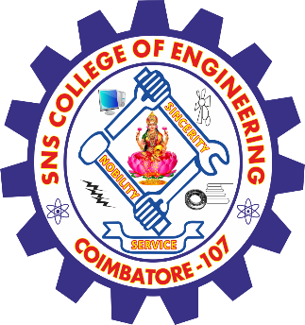
SNS COLLEGE OF ENGINEERING Kurumbapalayam(Po), Coimbatore – 641 107 Accredited by NAAC-UGC with ‘A’ Grade Approved by AICTE, Recognized by UGC & Affiliated to Anna University, Chennai
Department of AI &DS
Course Name – 19AD602 DEEP LEARNING
III Year / VI Semester
Unit 4-TRADITIONAL KNOWLEDGE AND INTELLECTUAL PROPERTY

Slide 2
TRADITIONAL KNOWLEDGE AND INTELLECTUAL PROPERTY
Traditional knowledge (TK) encompasses the know-how, skills, innovations, and practices developed and passed down through generations within indigenous and local communities.
This knowledge forms an integral part of their cultural and spiritual identities, covering areas such as agriculture, medicine, biodiversity conservation, and artistic expressions.
Protecting TK is essential to preserve cultural heritage, promote biodiversity, and prevent misappropriation.

Slide 3
TRADITIONAL KNOWLEDGE AND INTELLECTUAL PROPERTY
Various systems have been established to safeguard TK, including the adaptation of existing intellectual property (IP) frameworks.
These adaptations involve using tools like geographical indications, trademarks, and patents to protect traditional products and processes.
However, conventional IP systems often fall short in addressing the unique characteristics of TK, such as its collective ownership and intergenerational transmission.

Slide 4
TRADITIONAL KNOWLEDGE AND INTELLECTUAL PROPERTY
To address these limitations, many countries have developed sui generis systems—unique legal frameworks tailored specifically for TK protection.
Systems establish criteria for protection, define the rights granted, determine the duration of these rights, outline exceptions, and set enforcement mechanisms.
Sui generis approaches offer flexibility, allowing nations to craft legislation that aligns with their specific cultural and legal contexts.

Slide 5
TRADITIONAL KNOWLEDGE AND INTELLECTUAL PROPERTY
Internationally, organizations like the World Intellectual Property Organization (WIPO) have been instrumental in facilitating discussions on TK protection.
WIPO's Intergovernmental Committee on Intellectual Property and Genetic Resources, Traditional Knowledge and Folklore (IGC) has been negotiating legal instruments to safeguard TK, aiming to bridge gaps in international law and provide effective protection against misappropriation.

Slide 6
TRADITIONAL KNOWLEDGE AND INTELLECTUAL PROPERTY
Community-based initiatives also play a crucial role in protecting TK. Many indigenous communities have developed protocols and guidelines to manage access to their knowledge, ensuring that any utilization aligns with their cultural values and provides equitable benefits. These community-driven approaches empower indigenous peoples to maintain control over their TK and promote its sustainable use.

Slide 7
TRADITIONAL KNOWLEDGE AND INTELLECTUAL PROPERTY
Despite these efforts, challenges persist, including the need for greater international cooperation, the development of comprehensive legal frameworks, and the recognition of customary laws. Ongoing dialogue among governments, indigenous communities, and international bodies is essential to create effective systems that respect and protect traditional knowledge, ensuring its preservation for future generations.

Slide 8
TRADITIONAL KNOWLEDGE AND INTELLECTUAL PROPERTY
THANK YOU

